Slide 1
UX Research Portfolio
Abu Saleh Md Noman, MSc
Notes:
Email: snoman.0008@gmail.com

Slide 2
Contents
Background
Bio
Skills
Approach
Case Studies
Academic Case #1
Academic Case #2
Academic Case #3
Notes:
Click on links to skip to section.

Slide 3
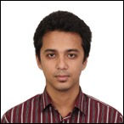
Bio
Hi, My name is Noman and I am a budding UX researcher specialized in studying social media user experience research. I have experience doing mixed-method research and analyzing interview, survey, and user-generated content. Since I am a Computer Science graduate, I substantiate the qualitative findings with data analysis (NLP, text mining, etc.)
I have 3+ years experience working in usable privacy group where we studied negative user sentiment. I have worked in multiple UX projects as part of the HCI coursework and MS thesis. I have published a paper on user behavior study in the most prominent HCI venue (CHI) on 2019.

Slide 4
Skills and Strengths
Qualitative Research Methods
Contextual Inquiry, Content Analysis, Ethnographic Field Studies, Focus Groups, Interviews, Usability Testing
Quantitative Research Methods
A/B Testing, Card Sorting, Surveys, Task Analysis, Web Analytics, Machine Learning, Data Mining, Statistical Analysis
Web Development
Front-End: HTML, CSS, JavaScript Databases: MySQL, MongoDB Programming: Python, Java, C
UX / UI Design
Graphics: Illustrator, Photoshop Prototyping: MockFlow, Visio Visualization: R, Tableau, Power BI

Slide 5

Research Philosophy
Discover Define
Develop Deliver
DISCOVER opportunities that translate to impact. DEFINE goals alongside partners. DEVELOP rigorous, efficient, multi-method research. DELIVER strategic insights that influence product direction.
Notes:
Discover | Define | Develop | Deliver
Double Diamond framework developed by UK Design Council.

Slide 6
Case Studies
[Academic Case #1]
Facebook UX: Techies against FB
[Academic Case #2]
TravelHappy: Designing for better travel experience
[Academic Case #3]
Technology non-use: Designing for inclusive online communities

Slide 7
Case Study #1: Facebook UX: Techies against Facebook
Problem Statement
Researchers have recognized the need to pay attention to negative aspects and non-use of social media services to uncover usage barriers and surface shortcomings of these systems. We contribute to these efforts by analyzing comments on posts related to Facebook on two blogs with a technically savvy readership: Slashdot and Schneier on Security.
Research Question
What factors lead technically savvy individuals to hold negative views toward social media services?
Notes:
DISCOVER | Define | Develop | Deliver

Slide 8
Context
Audience
Master’s thesis committee of 2 world experts in human-computer interaction.
Constraints
Tight turnaround of 12 weeks from research brief to data collection to analysis and final presentation. Difficulty in identifying non-users in naturalistic setting. Limited design operations support.
Action
As the Principal Investigator, I designed the entire multi-phase research project from beginning to end and defended results.
Team
Faculty Advisor (approved study ethics)
1 Research Assistant (coding)
Notes:
Discover | DEFINE | Develop | Deliver

Slide 9


Methods
Scraping
Filtering
Sampling
Sentiment Coding
Thematic coding
Data Collection
Slashdot
Schneier on Security
>= 100 Character
2000 from Slashdot (2010-2018)
1000 from Schneier (2006-2017)
Contains ‘Facebook’/ ‘FB’
Score >= +2
Notes:
Discover | DEFINE | Develop | Deliver

Slide 10


Stand Out Feature
Naturalistic data
Tech savvy population
Notes:
Discover | DEFINE | Develop | Deliver

Slide 11
Findings
Themes | #Comments (Slashdot) | #Comments (Schneier)
Privacy & Security | 432 (42.27%) | 212 (66.25%)
User Experience | 341 (33.36%) | 41 (12.81%)
Personal Disposition | 147 (14.38%) | 94 (29.37%)
Advertisements | 104 (10.17%) | 14 (4.37%)
Uninteresting Content | 39 (3.81%) | 28 (8.75%)
Miscellaneous | 35 (3.42%) | 34 (10.62%)
Alternate Options | 18 (1.76%) | 18 (5.62%)
Politics | 30 (2.93%) | 1 (0.31%)
Fake Accounts & Bots | 5 (0.49%) | 22 (6.87%)
Psychosocial Well-being | 9 (0.88%) | 7 (2.18%)
Notes:
Discover | DEFINE | Develop | Deliver
Overall agreement 97.3% (κ=0.96); 10 themes (NOT mutually exclusive)

Slide 12


Qualitative Analysis
Insight: Privacy & security and Negative UX are the major concerns
“Facebook is actively developing new, innovative ways to invade your privacy, and this particular bit of data mining technology has become reliable enough that they felt it would be good PR [Public Relations] to create a feel-good, help-the-disabled feature out of it.”
“If Facebook continues to make its site user-unfriendly, I’ll simply stop using Facebook. I’ve already dropped back on my usage because I cannot view my timeline the way I want to view it. . . ”
- Schneir on Security
- Slashdot
Notes:
Discover | Define | DEVELOP | Deliver

Slide 13
Insights
Negative sentiment (NS) can be a higher level aspect connected to non-use.
Intention and sentiment can be strong indicator of behavior and thus NS may strongly imply non-use even not explicitly mentioned.
Negative Sentiment
Reduced Usage
Complete Abandonment
Lurking
Notes:
Discover | Define | DEVELOP | Deliver

Slide 14


Recommendations
Unsolicited naturalistic user generated content can be useful for uncovering user sentiment and practices
Tech-savvy users can help designers uncover problematic operation details
Notes:
Discover | Define | DEVELOP | Deliver

Slide 15
Impact
Design Implication
Study provided implications for design improvement to facilitate non-use
Work was published at CHI’19 and gained attraction from FB UX designers
Final Deliverable & Future Work
Written report for the thesis committee
Encouraged future work which extended for general population
Supervised 6+ undergrad students who eventually worked with related study
Notes:
Discover | Define | Develop | DELIVER

Slide 16
Case Study #2: TravelHappy: Designing for better travel experience
Problem Statement
With the rapid growth of technology including websites, mobile apps, online travel agencies etc., modern travelers use tech­nology more than ever before. Although latest travel search engines like Travelocity, Expedia and TripAdvisor make it easy to plan trips beforehand; we wanted to see how much influence it really has on deciding where to go and what type of experiences to get.
Project Goal
Understanding the influence of existing technology on travelers planning.
Understanding the demand of travelers and find the correlation of this with their plans.
Providing a prototype fulfilling their demands.
Trying to overcome the drawbacks of existing technology (e.g. lack of family friendly travel planning media).
Notes:
DISCOVER | Define | Develop | Deliver

Slide 17
Context
Audience
2 renowned HCI Faculty; Class of 30+ HCI graduate students
Constraints
No budget for compensating interview participants or outsourcing audio transcriptions.
Action
Recruited participants, conducted sessions with users, and presented findings in the class.
Team
1 project partner (created prototypes)
Notes:
Discover | DEFINE | Develop | Deliver

Slide 18
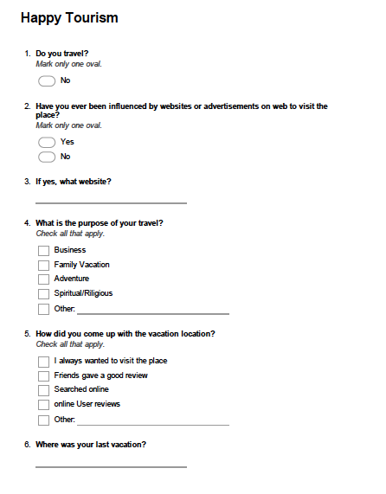
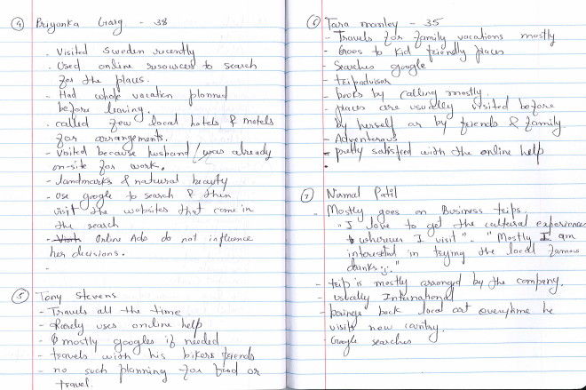
Methods
Recruitment
Our target population was adults over the age of 18 who travel and are familiar with the online technologies available. Interviewees were mostly friends and colleagues who travel for business as well as for family vacations.
Interview
We interviewed 20 travelers for our research purposes. Nature of each interview was open-ended.
Survey
Based on the interview results and feedback we received from the travelers we created a survey using www.surveymonkey.com
Notes:
Discover | DEFINE | Develop | Deliver

Slide 19
Qualitative Analysis
During the open-coding step, the codes that we ended up with were:
• Google search
• No influence of online ads
• Landmark
• Cultural experience
• Adventure
• Family vacation
• Tripadvisor
• Business trip
• Kayak, Orbit etc.
• Cheap deals
• Recommended by friends
• Mobile apps
Later in the axial coding step, we categorized them into
further groups:
Subcategory 1: Technology
• Code: Google search
• Code: No influence of online ads
• Code: Tripadvisor
• Code: Kayak, Orbit etc.
• Code: Cheap deals
• Code: Mobile apps
Subcategory 2: Experience
• Code: Landmark
• Code: Cultural experience
• Code: Adventure
• Code: Family vacation
• Code: Both
• Code: Business trip
Notes:
Discover | Define | DEVELOP | Deliver

Slide 20
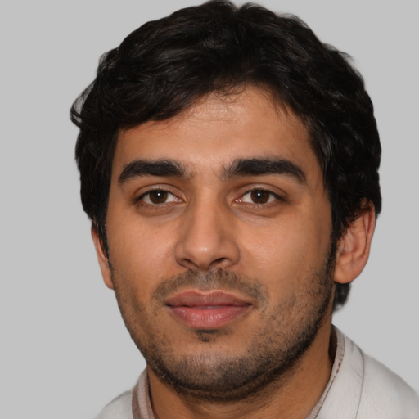
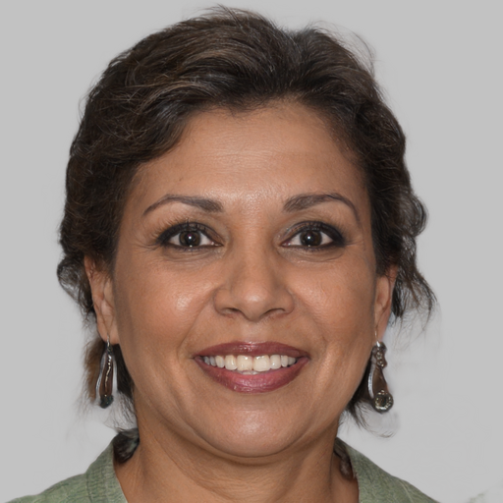
Qualitative Analysis
“I personally like to get more cultural experience but for my kids and others visiting famous landmarks and taking pictures is important so they can remember and reference back to the trip when they grow up”
“I don’t mind spending time on some extra google search browsing. But it would be nice to see a new interface combining them”
Raphael
Business Analyst
(41, M)
Camilla
Art Gallery Curator
(35, F)
Notes:
Discover | Define | DEVELOP | Deliver.
Names are pseudonymized to protect the privacy of users. Artificially generated faces are used in their place: https://generated.photos/faces

Slide 21
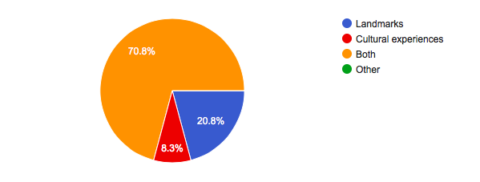
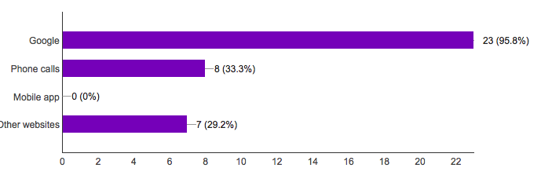
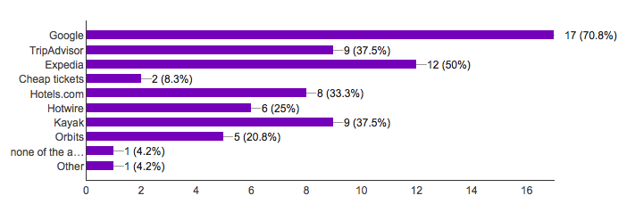
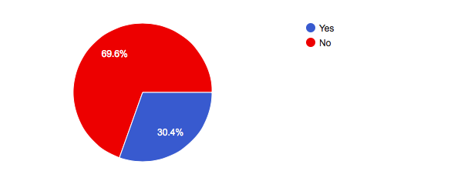
Survey Findings
When planning a vacation/travel how do you gather information about the place?
When traveling do you visit landmarks or looking for cultural experiences?
When making travel arrangements which of the following do you use?
Have you ever been influenced by websites or advertisements on web to visit the place?
Notes:
Discover | Define | DEVELOP | Deliver

Slide 22
Insights
Travelers mostly travel with friends and family
Trips are mostly three to four days’ long
Travelers use google search to begin planning for the trip and to get more information about the destination.
Visit the places suggested by friends and family.
Majority of the travelers are not influenced by web advertisements, blogs or forums.
Travelers would like to see easily available information for family friendly locations, road conditions etc.
Notes:
Discover | Define | DEVELOP | Deliver

Slide 23
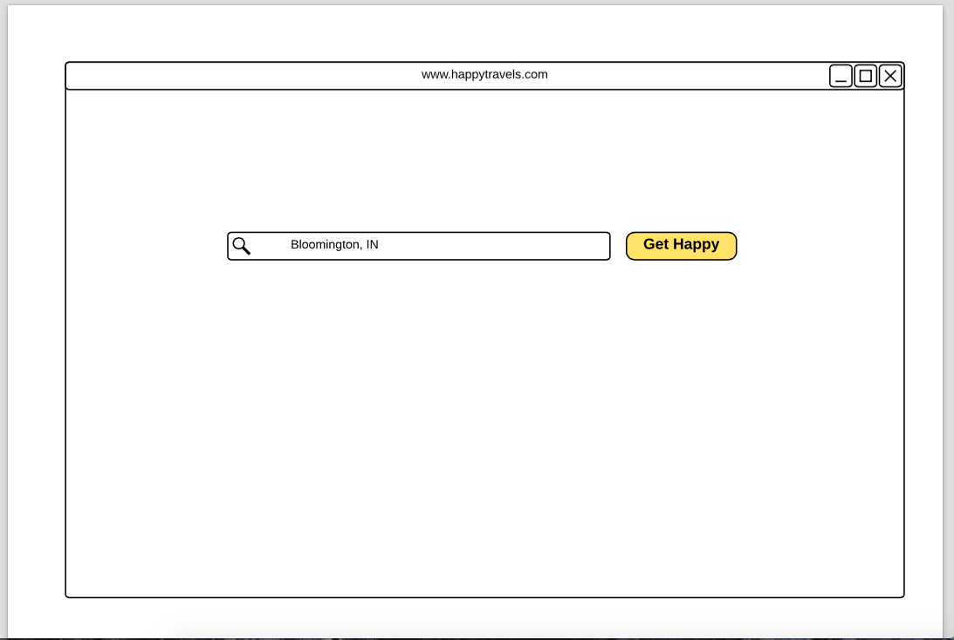
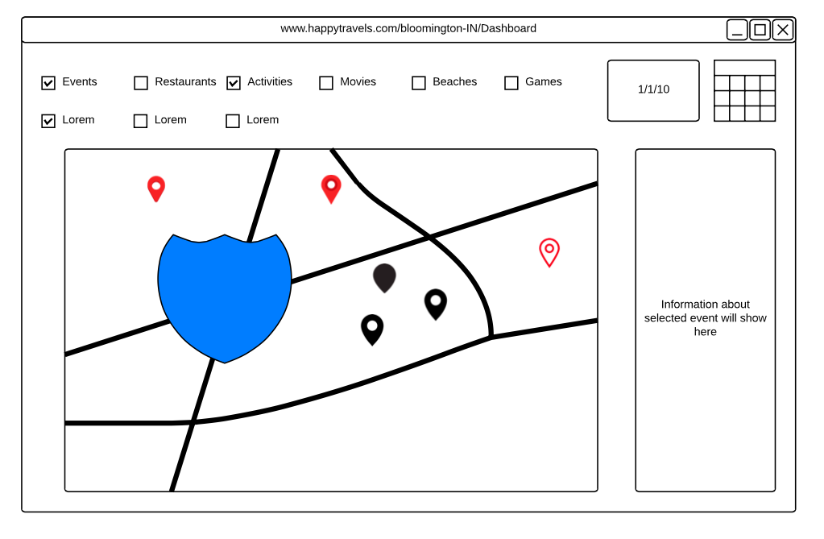
Recommendations
Proposed a basic wireframe prototype of family friendly travel search engine
Home page of the website
Search result for the submitted travel destination
Notes:
Discover | Define | Develop | DELIVER

Slide 24
Impact
Usability Test & Feedback
Upon presenting our prototype before a class of Human-Computer Interaction students we received many interesting and encouraging feedbacks:
“Very thoughtful prototype. I'm sure many families would enjoy a service like this. You might include an area for tips like on Yelp. Family friendly (casual, cheap) restaurants would also be good to include!”
“This is an interesting. I think it would be nice to take interaction design into consideration in the future improvement. Then we can get some real feedback from parents and kids, since different family may have different needs.”
Final Deliverable
Written report and final class presentation
Notes:
Discover | Define | Develop | DELIVER

Slide 25
Case Study #3: Technology Non-use: Designing for inclusive online communities
Problem Definition
Via interviews with individuals who indicated reduced use of Facebook, we describe the variety of ways in which use limiting may be practiced. Our findings lead to a framework for understanding, and designing for, selective engagement.
Research Question
How can the characterization of non-use and non-adoption of Facebook be refined and extended?
Notes:
DISCOVER | Define | Develop | Deliver

Slide 26
Context
Audience
Research committee of 2 world experts in human-computer interaction & Usable privacy research group members.
Constraints
The qualitative nature of the study and personal interviews made the demographics skew mostly towards students.
Action
As the supporting Investigator, I helped design the research instruments and coding process.
Team
Faculty Advisor (approved study ethics)
1 Research Assistant (coding & interview)
Notes:
Discover | DEFINE | Develop | Deliver

Slide 27
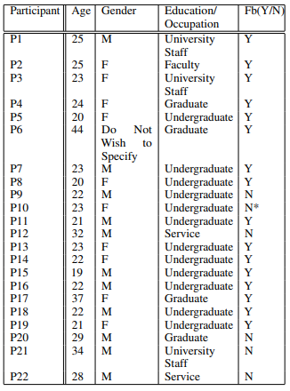
Methods
Recruitment
We recruited participants between December 2016 to May 2017 using a short screening questionnaire distributed via mailing lists, online forums, etc.
Interview
We conducted semi-structured interviewed with 22 participants over the age of 18 who indicated having lived in the US for at least 5 years
Notes:
Discover | DEFINE | Develop | Deliver

Slide 28
Qualitative Analysis
“They (Facebook) want to probably make a lot of money, they use my data to probably track where, what sites I visit or what types of posts I subscribe to, they want to maybe know my spending habits, the types of movies I watch, they probably analyze the entire thing, for their benefit, they just want to keep me as their customer, as a consumer, so that they can keep their billions.”
“I think it was gradual. I enjoy producing content now as a writer producing plays in my free time. I think Facebook is not the type of audience I wanted for what I do. I’m not a high artist or anything like that. ”
- P7
- P20
Notes:
Discover | Define | DEVELOP | Deliver

Slide 29
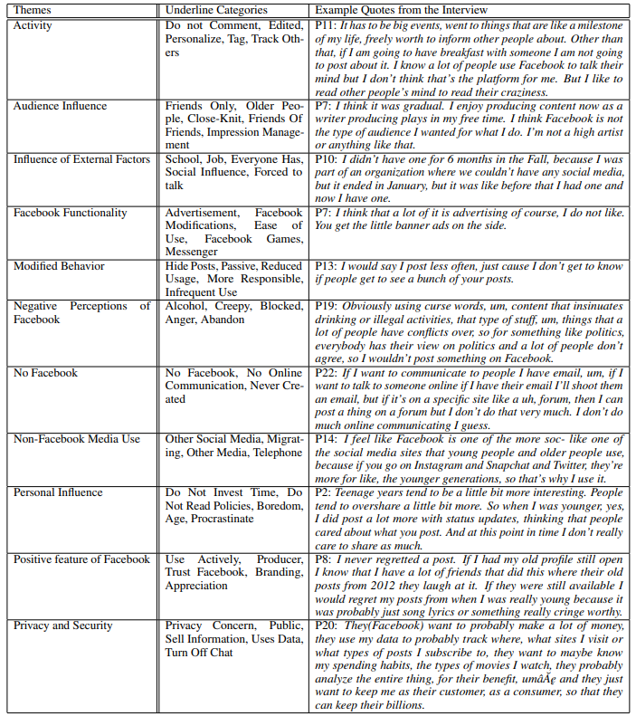
Insights
Notes:
Discover | Define | DEVELOP | Deliver

Slide 30
Recommendations
Feature based
Users use Facebook only for particular features and abandon the rest
People based
Use Facebook to connect with a particular subset of their friend-list instead of connecting with everyone
Time based
Users use Facebook depending on one’s availability, such as while travelling, or during ideal time and ignore the rest of the time
Tool based
Privacy/
ideology based
Highlight based
Users use in ways that preserve privacy e.g., via passive consumption or self censorship
e.g., Adblock, encryption methods of messenger
Users post only about the highlights of their life and avoid posting mundane activities or what’s in their mind
Framework for non-use typology
Notes:
Discover | Define | DEVELOP | Deliver

Slide 31
Let’s connect!
Contact Information
Social Media: in/amdnoman
Email: snoman.0008@gmail.com
Notes:
Please send questions and share any feedback my way!

